Slide 1
High Altitude Physiology
Dr Dulani Kottahachchi
Department of Physiology

Slide 2
Objective
To understand the ventilatory response to high altitude

Slide 3
With increasing altitude
↓ barometric pressure
Fraction of O₂ in air does not decrease (20.9%)
(PO₂ = barometric P × Fraction of O₂ in air )
↓ PO₂ in inspired air (P_{i}O₂)
↓ P_{A}O₂
↓ PaO₂ and O₂ content of blood
HYPOXIC HYPOXIA
Adaptation of the body to the hypoxia causes symptoms and signs

Slide 4
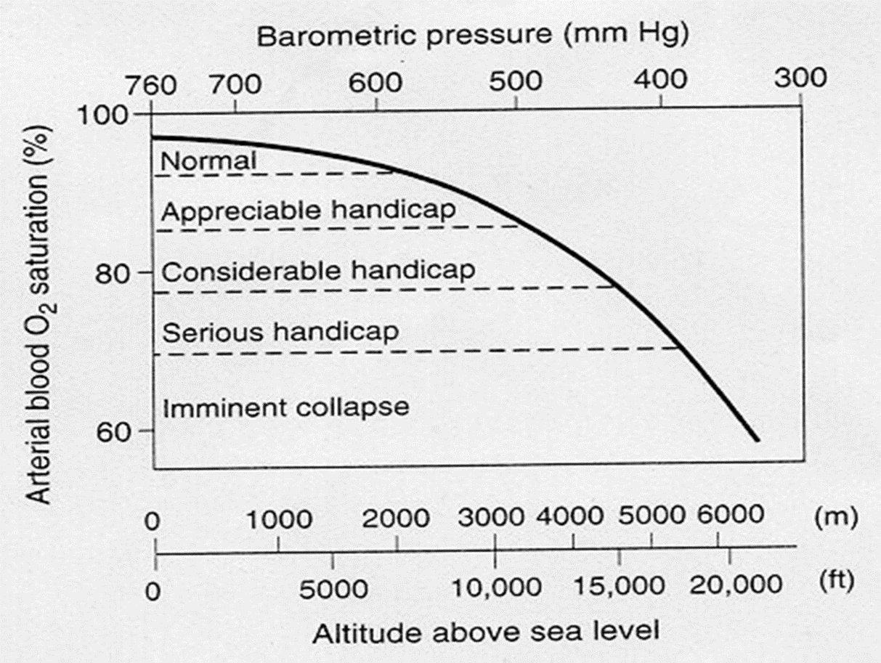
Acute effects of hypoxia in individuals breathing air at various altitudes
3000m- PAO2- 60mmHg
3700m – mental symptoms- irritability
5500m-severe hypoxic symptoms
>6100m- consciousness lost

Slide 5
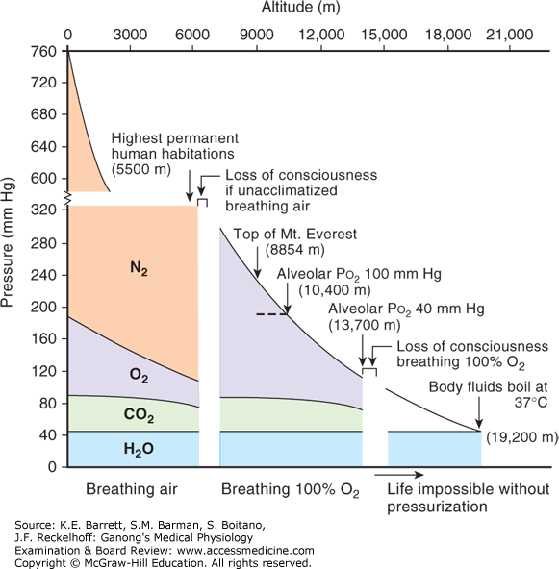
Composition of alveolar air in individuals breathing air or 100% O₂
Limiting factor in altitude tolerance- is atmospheric pressure
At 14000m- Loss of consciousness
At 19200m- barometric pressure is 47 mm Hg

Slide 6
Acclimatization
Is a physiological response in an individual to increase altitude tolerance.
  Air is thinner and lack of oxygen
Due to the operation of a variety of compensatory mechanisms that begins within hours
Adaptations occur in:
  Ventilation
  Hb-O₂ affinity
  Erythropoietin
  Hb concentration
  Microcirculation
  Cellular metabolism

Slide 7
Physiological Responses to High Altitude
Immediate
Early Adaptive (72 hours)
Late Adaptive (2-6 weeks)

Slide 8
Acclimatization
PAO2 ↓ Hyperventilation PACO2 ↓, Respiratory alkalosis
Renal compensation –within hours HCO3 excretion and H+ conservation
Cardiac out put, HR, BP ↑-to increase the supply of oxygen to your brain and muscles
  Becomes normal after a month – due to ↓ sympathetic activity
Pulmonary hypoxic vasoconstriction pulmonary HT
Cor-pulmonale RV hypertrophy

Slide 9
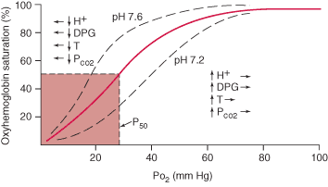
Hb-O₂ affinity-
PAO2 ↓ Hyperventilation PACO2 ↓, Respiratory alkalosis
O2-Hb dissociation curve shift to left
In RBC- ↑ 2,3-DPG - ↓ O2 affinity of Hb
Small ↑ in P50
O2 release at tissue enhanced
Initially shifts to the right at moderate altitudes
  Due to 2,3 DPG
Notes:
At extreme altitude, it shifts to the left
Due to much less CO2 in the blood

Slide 10
Ventilatory Acclimatization
Initially,
↓ PaO2 stimulates arterial chemoreceptors and results in ↑ minute ventilation
↑ ventilation leads to ↓PaCO2
Alkalosis counteracts stimulation produced by hypoxia
Initial ventilator response –relatively small

Slide 11
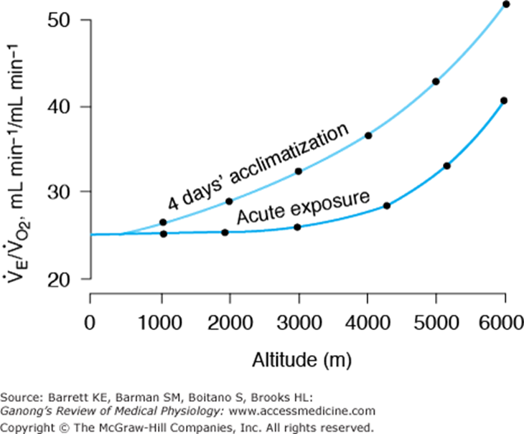
Ventilatory Acclimatization contd..
Ventilation steadily ↑ over next 4 days
  Active transport of H+ to CSF
  Or developing lactic acidosis of the brain
  ↓pH in CSF - ↑ response to hypoxia

Slide 12
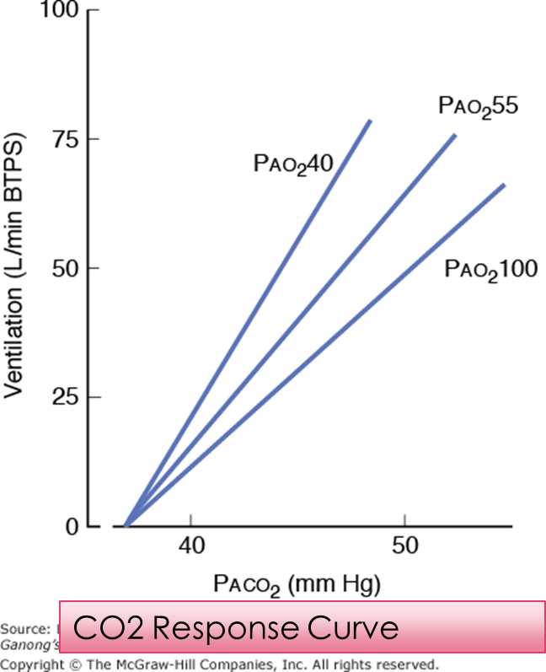
Ventilatory Acclimatization contd..
Ventilatory response curve to CO2 shift to the left- after several days
Ventilatory response ↑
CSF fluid pH return to normal and CNS symptoms abate.
After 4 days –ventilator response begin to decline

Slide 13
Ventilatory Response to Hypoxia
Persons born at high altitudes show a ↓ ventilatory response to hypoxia
Persons born at sea level and moved to high altitude for years – normal ventilatory response to hypoxia

Slide 14
Erythropoietin and RBC
Erythropoietin secretion ↑ promptly and ↓ over the next 4 days
  Due to ↑ ventilator response and ↑ PaO2
↑ circulating RBC begins in 2-3 days
Sustained as long as remaining in high altitude
Increased Hematocrit and O2 carrying capacity

Slide 15
In Tissues
  Mitochondria ↑ in number
  Myoglobin ↑- movement of O2 into tissue ↑
  Cytochrome oxidase content ↑

Slide 16
What is this ‘hypoxia of altitude”?
Acute hypoxia
In subjects exposed to altitude for a few minutes to hours
If a person rapidly ascends leads to “ acute mountain sickness “
Chronic hypoxia
In subjects living for longer periods at high altitudes
Ex-
  In mountaineers who have become acclimatized
  Natives
Low PAO2
Polycythemic
Barrel-chested

Slide 17
Acute mountain sickness
Acute mountain sickness- develops 8-24 hours after and lasts 4-8 days
Headache, Irritability, insomnia, breathlessness,
Nausea and vomiting.
Associated with cerebral oedema
  Low PO2 cause arteriolar dilation,(if cerebral autoregulation doesn’t compensate), ↑capillary pressure, ↑transudation of fluid into brain tissue

Slide 18
Chronic mountain Sickness
Develop in some individuals residing in high-altitude areas
CF- Cyanosis, fatigue, marked polycythemia and profound hypoxaemia
Need to descend to lower altitudes

Slide 19
High Altitude Pulmonary Oedema
Patchy oedema of the lungs related to marked pulmonary HT
Due to stress failure in capillaries
Symptoms-
  Severe dyspnea –at rest
  Orthopnea, cough, coughing up pink, frothy fluid
Treatment
O2-use hyperbaric chamber if possible
Nifidipine- Ca2+ channel blocker- ↓ pulmonary artery pressure
Should be adviced against going back to high-altitudes

Slide 20
High Altitude Cerebral Oedema
Capillary leakage in mountain sickness progresses to frank brain swelling
CF- Ataxia, Disorientation,
Coma and death due to herniation of brain through the tentorium.
Needs immediate descent

Slide 21
Who are the first Sri Lanakan’ s to climb mount Everest?

Slide 22
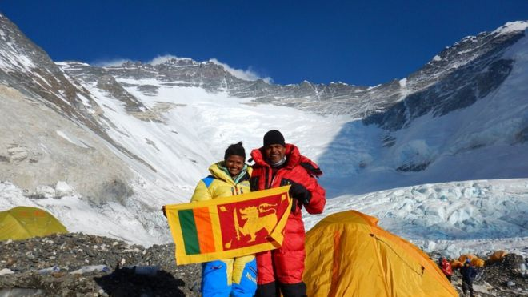
First Sri Lanakan’ s to climb mount Everest
JayanthiKuru-Utumpala and Johann Peries

